Slide 1
Spherical System and Transformations

Slide 2
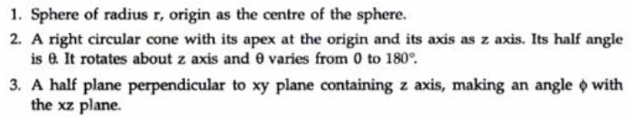
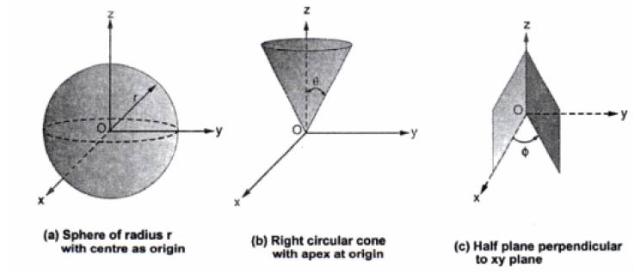

Slide 3
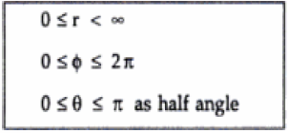
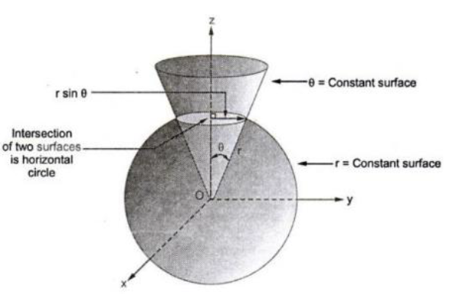
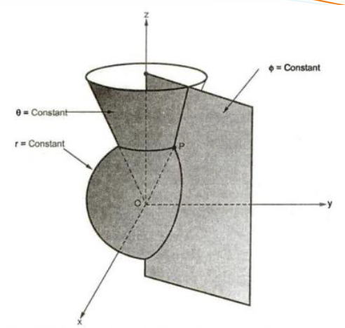

Slide 4
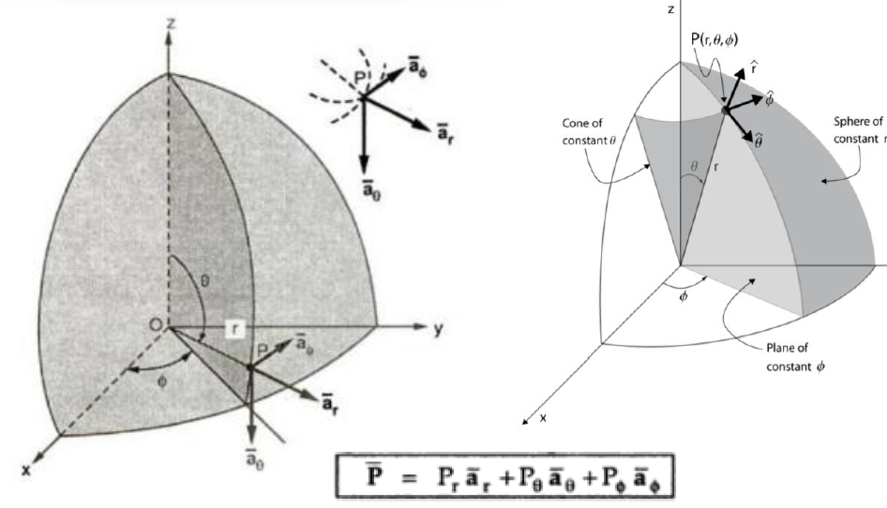

Slide 5
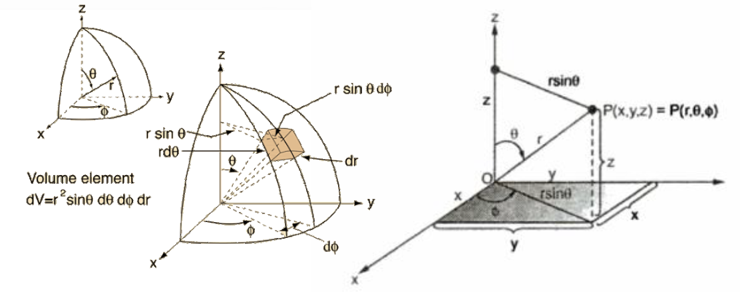

Slide 6
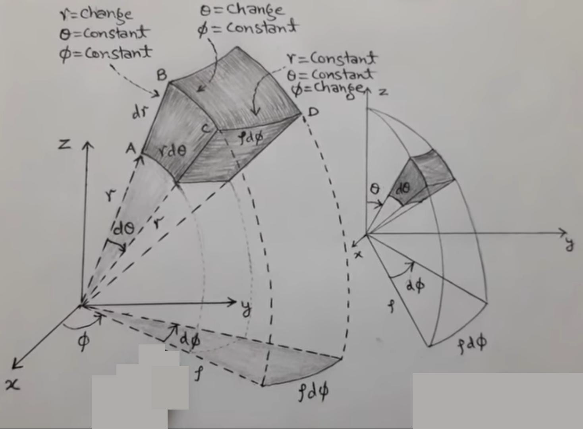

Slide 7
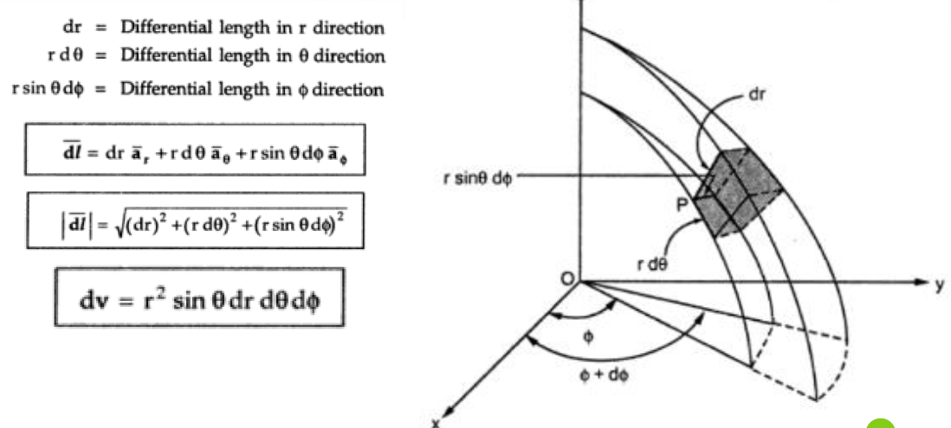

Slide 8
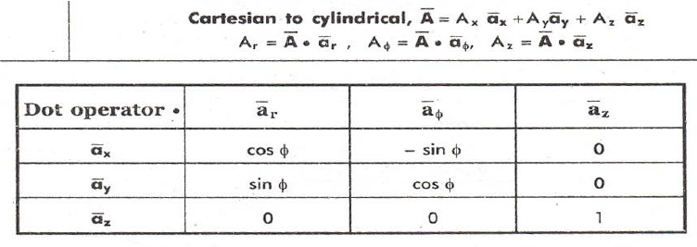
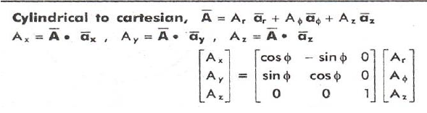
Vector transformation

Slide 9
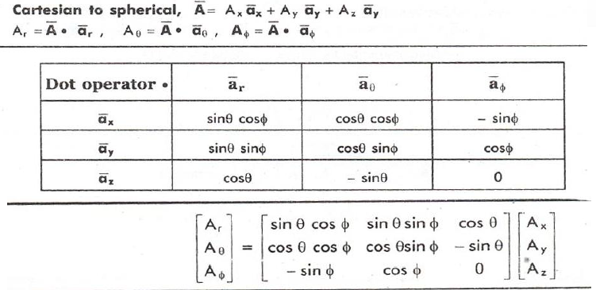
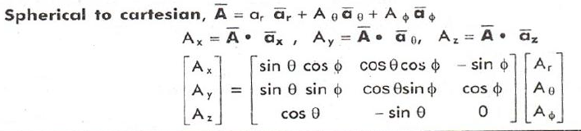

Slide 10
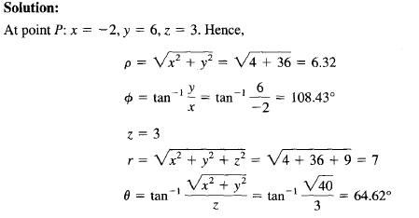
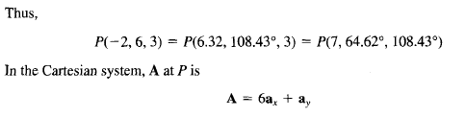
Example

Slide 11
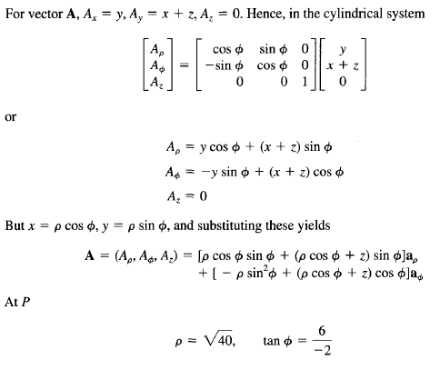

Slide 12
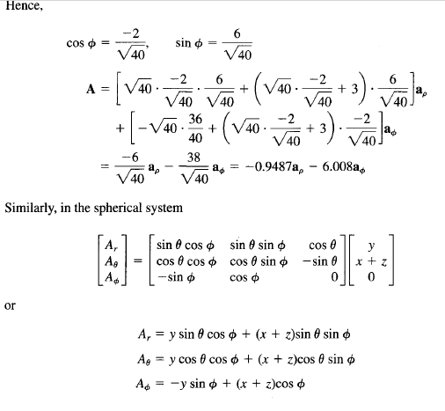

Slide 13
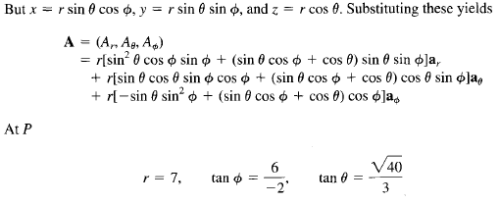
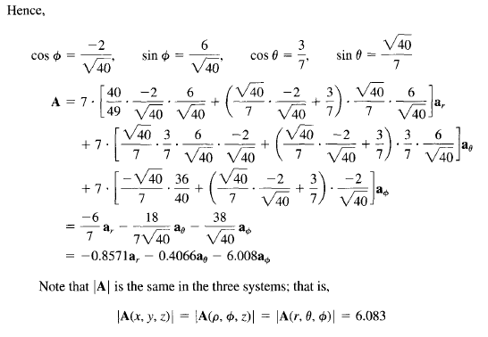

Slide 14


LINE, SURFACE, AND VOLUME INTEGRALS
By a line we mean the path along a curve in space. We shall use terms such
as line, curve, and contour interchangeably
Given a vector field A and a curve L, we define the integral

Slide 15
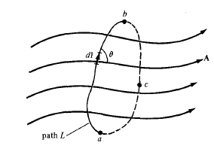



If the path of integration is a closed curve such as abca becomes a closed contour integral
Given a vector field A, continuous in a region containing the smooth surface S, we
define the surface integral or the flux of A through S

Slide 16
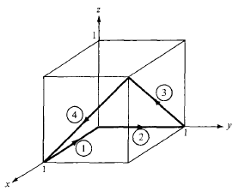
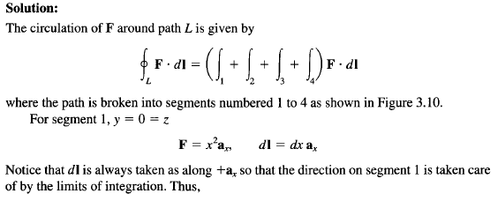
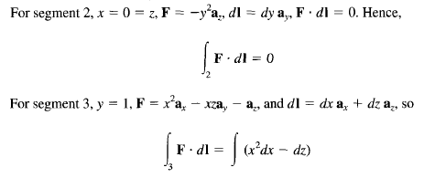

EXAMPLE

Slide 17
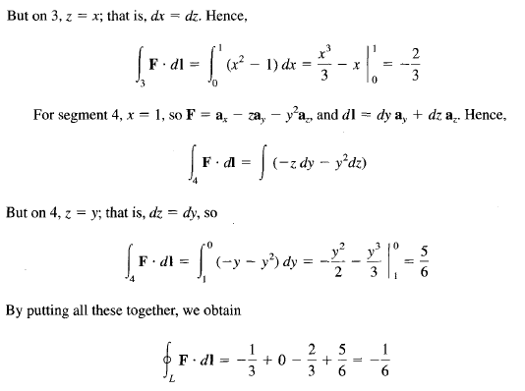

Slide 18
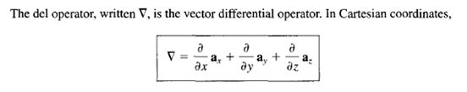

DEL OPERATOR
This vector differential operator, otherwise known as the gradient operator, is not a vector
in itself, but when it operates on a scalar function, for example, a vector ensues. The operator is useful in defining

Slide 19


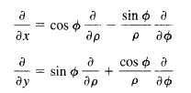

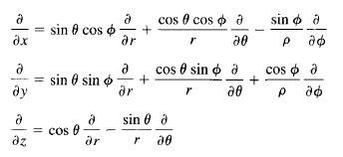


In cylindrical systems
In spherical systems

Slide 20
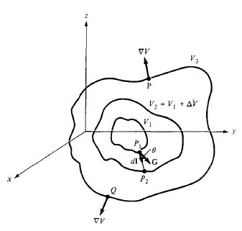
GRADIENT OF A SCALAR
The gradient of a scalar field V is a vector that represents both the magnitude and the direction of the maximum space rate of increase of V.
A mathematical expression for the gradient can be obtained by evaluating the difference in
the field dV between points P1 and P2

Slide 21





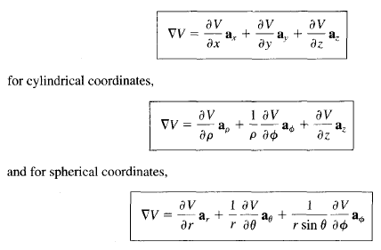
Let
Thus G has its magnitude and direction as those of the maximum rate of change of V

Slide 22
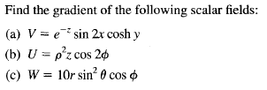



Example

Slide 23
END
NEXT??
DIVERGENCE AND CURL

